Slide 1
MY JOURNAL TO PYTHON
NAME: 珍古絲汀
TEACHER:

Slide 2
AGENDA
PYTHON
INPUT AND OUTPUT: INPUT() AND PRINT()
DATA TYPES: NUMERIC, STRINGS, LIST , DICT.
OPERATORS ON DATA TYPE:
CONTROLS : IF- | IF –ELSIF |-F-ELSE
LOOP: FOR |WHILE | RANGE() | BREAK | CONTINUE
FUNCTION:
PARAMETERS(ARGUMETNS)
RECURSIVE FUNCTION
LAMBDA FUNCTION

Slide 3
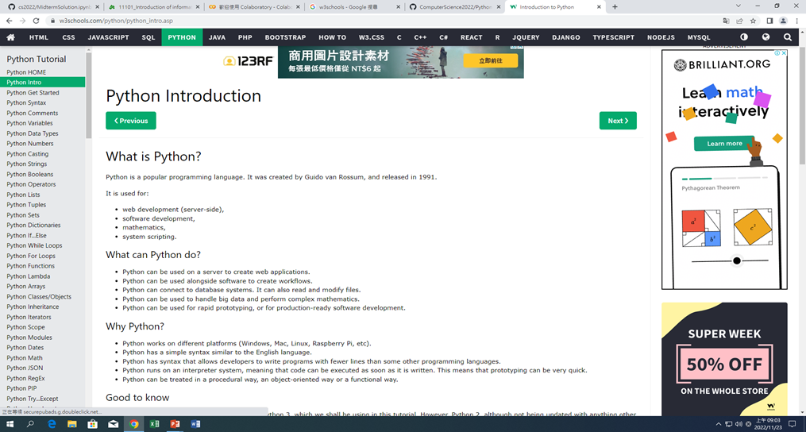
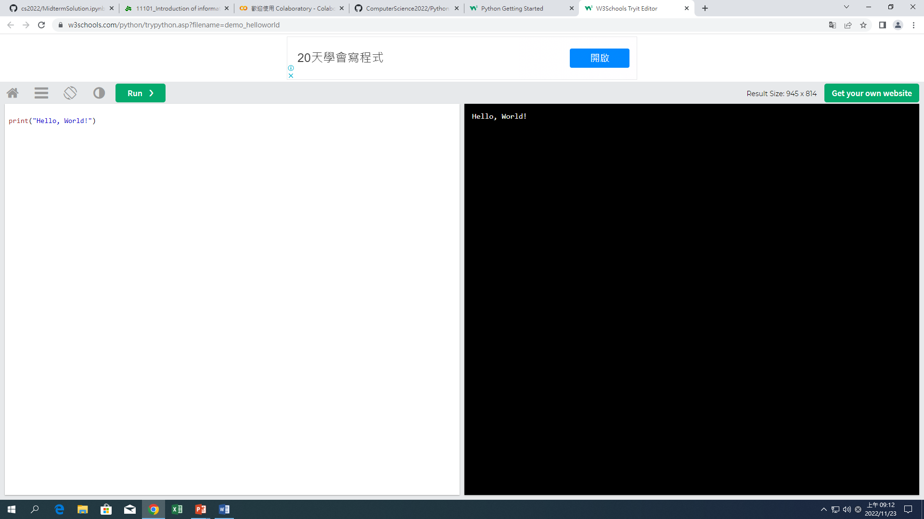
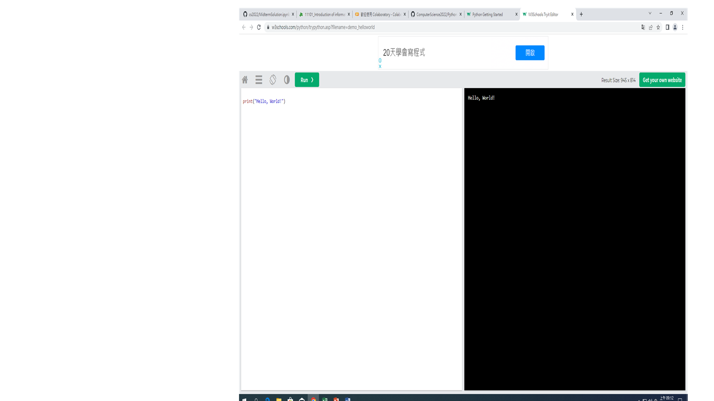
PYTHON
1 | What can Python do? (A)Python can be used on a server to create web applications. (B)Python can be used alongside software to create workflows. (C)Python can connect to database systems. It can also read and modify files. (D)Python can be used to handle big data and perform complex mathematics.
 | https://www.w3schools.com/python/python_intro.asp
EXAMPLE:

Slide 4
PYTHON SYNTAX EXECUTE PYTHON SYNTAX
Python syntax can be executed by writing directly in the Command Line:
Or by creating a python file on the server, using the .py file extension, and running it in the Command Line:
>>> print("Hello, World!") Hello, World!
C:\Users\Your Name>python myfile.py

Slide 5

PYTHON IDENTATION
Indentation refers to the spaces at the beginning of a code line. Where in other programming languages the indentation in code is for readability only, the indentation in Python is very important. Python uses indentation to indicate a block of code.
EXAMPLE:

Slide 6
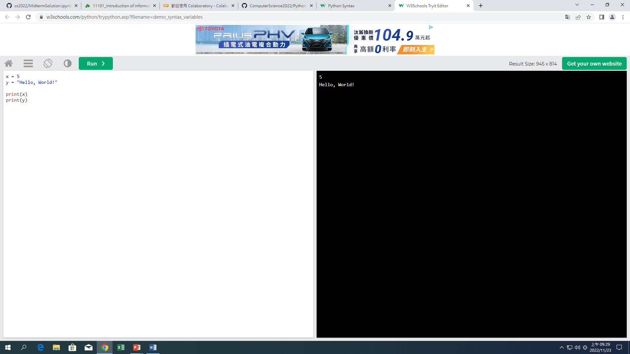
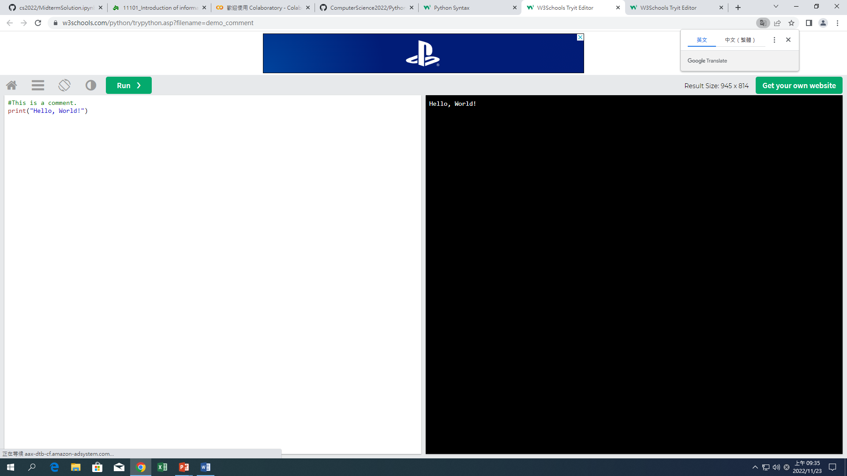
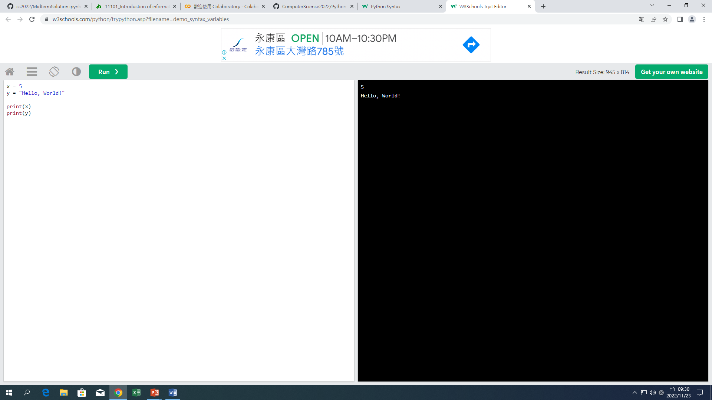
PYTHON VARIABLES
In Python, variables are created when you assign a value to it:
Comments
Python has commenting capability for the purpose of in-code documentation.
Comments start with a #, and Python will render the rest of the line as a comment:
EXAMPLE:
EXAMPLE:

Slide 7
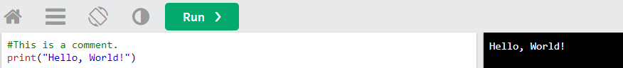
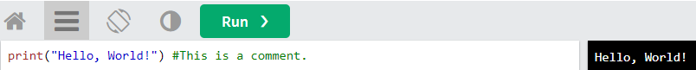
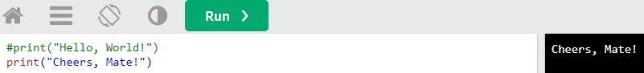
CREATING A COMMENT
Comments starts with a #, and Python will ignore them:
Comments can be placed at the end of a line, and Python will ignore the rest of the line:
A comment does not have to be text that explains the code, it can also be used to prevent Python from executing code:

Slide 8
PYTHON COMMENTS
Comments can be used to explain Python code.
Comments can be used to make the code more readable.
Comments can be used to prevent execution when testing code.

Slide 9
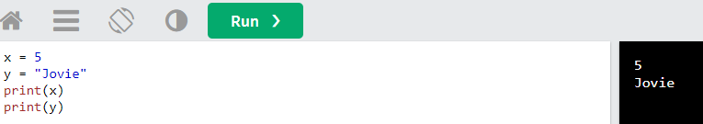
PYTHON VARIABLES
VARIABLES
Variables are containers for storing data values.
CREATING VARIABLES
Python has no command for declaring a variable.A variable is created the moment you first assign a value to it.

Slide 10
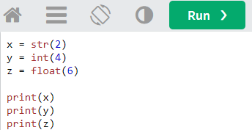
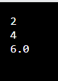
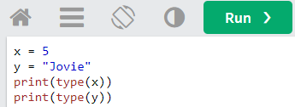
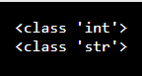
CASTING
GET THE TYPE
If you want to specify the data type of a variable, this can be done with casting.
You can get the data type of a variable with the type() function.

Slide 11
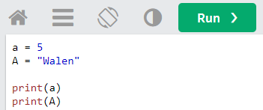
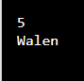
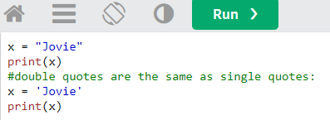
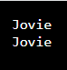
SINGLE OR DOUBLE QUOTES?
CASE-SENSITIVE
String variables can be declared either by using single or double quotes:
Variable names are case-sensitive.

Slide 12
VARIABLE NAMES
A variable can have a short name (like x and y) or a more descriptive name (age, car name, total volume). Rules for Python variables : A variable name must start with a letter or the underscore character
A variable name cannot start with a number
A variable name can only contain alpha-numeric characters and underscores (A-z, 0-9, and _ )
Variable names are case-sensitive (age, Age and AGE are three different variables)

Slide 13
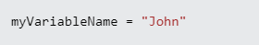
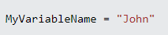
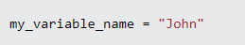
Multi Words Variable Names
Variable names with more than one word can be difficult to read. There are several techniques you can use to make them more readable:
Came
Each word, except the first, starts with a capital letter:
Pascal Case
Each word starts with a capital letter:
Snake Case
Each word is separated by an underscore character:

Slide 14
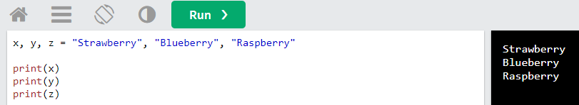
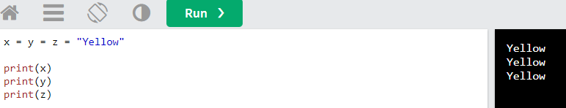
PYTHON VARIABLES ASSIGN MULTIPLE VALUES
VALUES TO MULTIPLE VARIABLES
Python allows you to assign values to multiple variables in one line:
ONE VALUE TO MULTIPLE VARIABLES
And you can assign the same value to multiple variables in one line:

Slide 15
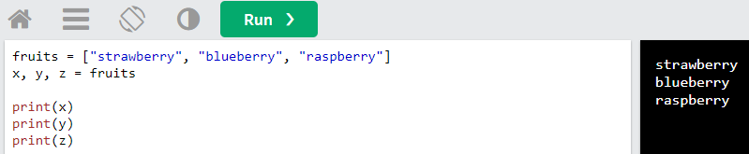
PYTHON VARIABLES ASSIGN MULTIPLE VALUES
UNPACK A COLLECTION
If you have a collection of values in a list, tuple etc. Python allows you to extract the values into variables. This is called unpacking.

Slide 16
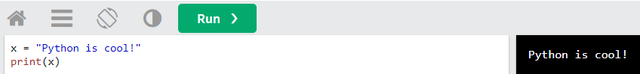
PYTHON VARIABLES - OUTPUT VARIABLES
OUTPUT VARIABLES
The python print() function is often used to output variables

Slide 17
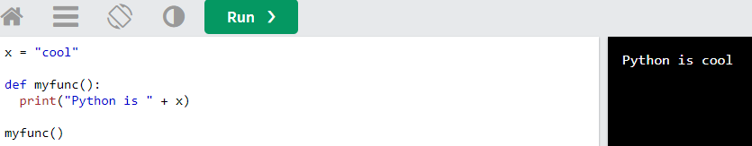
PYTHON VARIABLES - GLOBAL VARIABLES
GLOBAL VARIABLES
Variables that are created outside of a function (as in all of the examples above) are known as global variables. Global variables can be used by everyone, both inside of functions and outside.

Slide 18
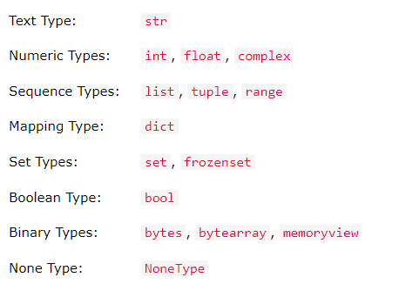
PYTHON DATA TYPES BUILT-IN DATA TYPES
In programming, data type is an important concept.Variables can store data of different types, and different types can do different things.Python has the following data types built-in by default, in these categories:

Slide 19
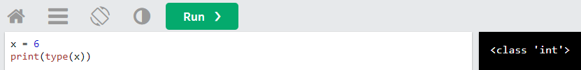
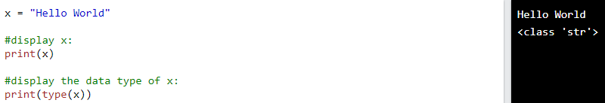
PYTHON DATA TYPES GETTING THE DATA TYPE
You can get the data type of any object by using the type() function:
SETTING THE DATA TYPE
In python, the data type is set when you assign a value to a variable:
EXAMPLE
DATA TYPE : str

Slide 20
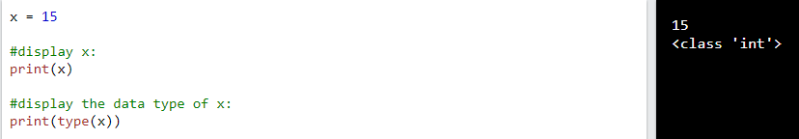
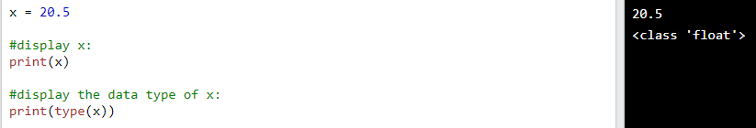
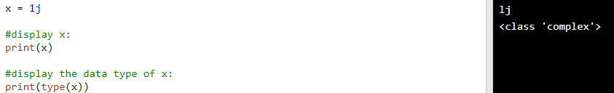
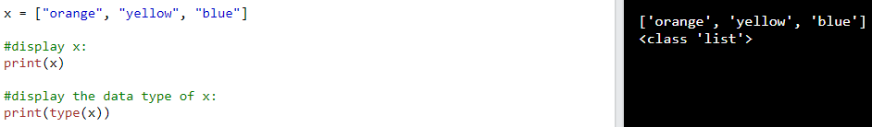
SETTING THE DATA TYPE
DATA TYPE :int
DATA TYPE : float
DATA TYPE: complex
DATA TYPE : list

Slide 21
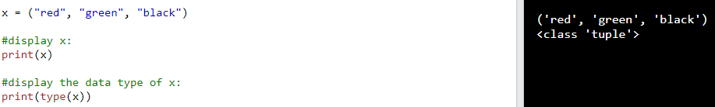
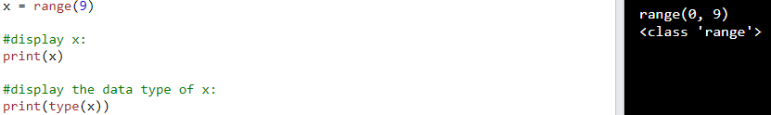
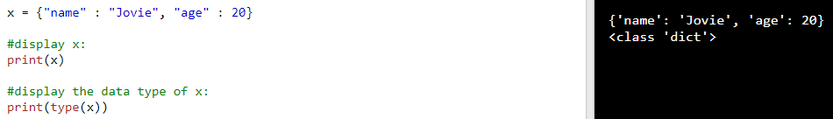
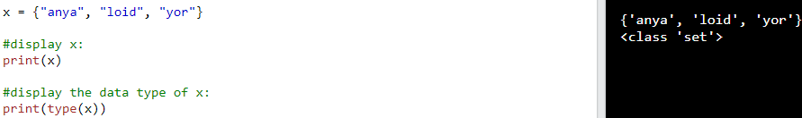
SETTING THE DATA TYPE
DATA TYPE : tuple
DATA TYPE : range
DATA TYPE : dict
DATA TYPE : set

Slide 22
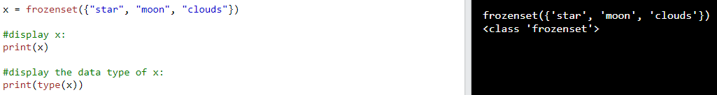
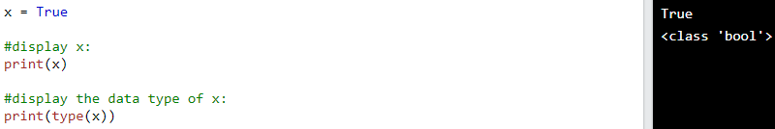
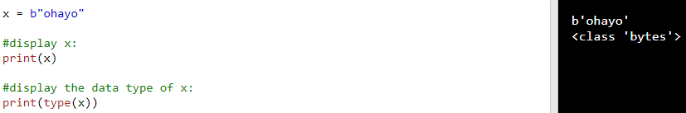
SETTING THE DATA TYPE
DATA TYPE : frozenset
DATA TYPE :bool
DATA TYPE :bytes

Slide 23
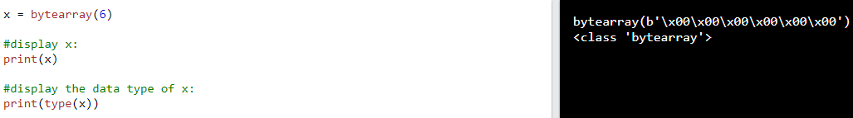
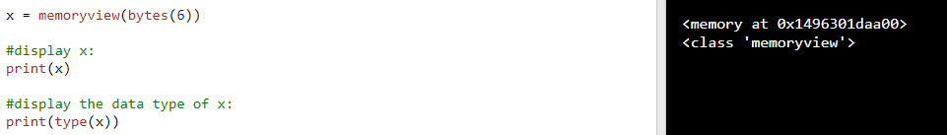
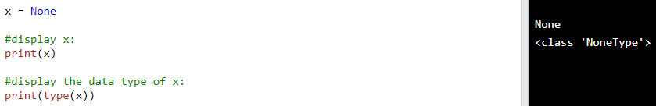
SETTING THE DATA TYPE
DATA TYPE :bytearray
DATA TYPE :memoryview
DATA TYPE : NoneType

Slide 24
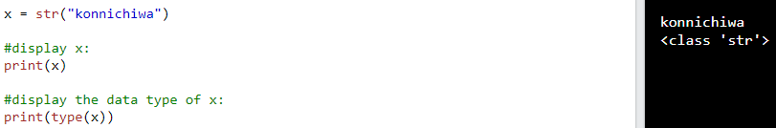
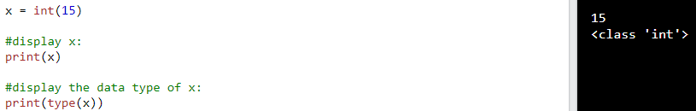
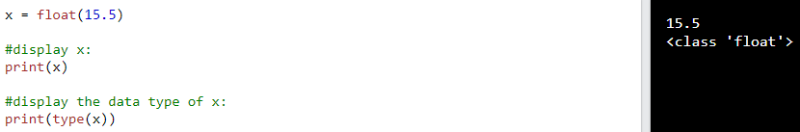
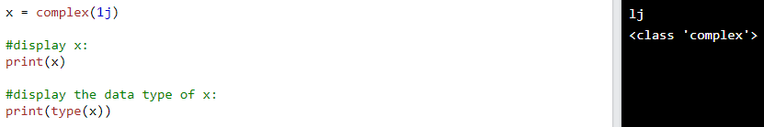
PYTHON DATA TYPES Setting the Specific Data Type
DATA TYPE :str
DATA TYPE :int
DATA TYPE :float
DATA TYPE :complex

Slide 25
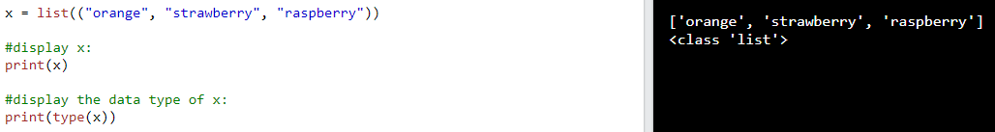
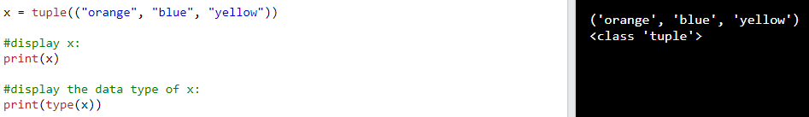
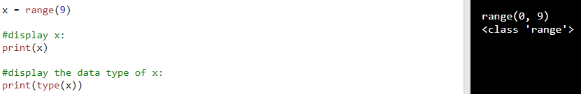

PYTHON DATA TYPES Setting the Specific Data Type
DATA TYPE :list
DATA TYPE :tuple
DATA TYPE :range
DATA TYPE :dict

Slide 26



PYTHON DATA TYPES Setting the Specific Data Type
DATA TYPE :set
DATA TYPE :frozenset
DATA TYPE :bool

Slide 27



PYTHON DATA TYPES Setting the Specific Data Type
DATA TYPE :bytes
DATA TYPE :bytearray
DATA TYPE :memoryview

Slide 28



PYTHON NUMBERS
PYTHON NUMBERS
There are three numeric types in Python:
int
float
complex
Variables of numeric types are created when you assign a value to them:
To verify the type of any object in Python, use the type() function:

Slide 29


PYTHON NUMBERS
INT
Int, or integer, is a whole number, positive or negative, without decimals, of unlimited length.

Slide 30




PYTHON NUMBER
FLOAT
COMPLEX
Float, or "floating point number" is a number, positive or negative, containing one or more decimals.
Complex numbers are written with a "j" as the imaginary part:

Slide 31


PYTHON NUMBERS
Type Conversion
You can convert from one type to another with the int(), float(), and complex() methods:

Slide 32


PYTHON NUMBERS
RANDOM NUMBER
Python does not have a random() function to make a random number, but Python has a built-in module called random that can be used to make random numbers:

Slide 33

PYTHON CASTING SPECIFY A VARIABLE TYPE
There may be times when you want to specify a type on to a variable. This can be done with casting. Python is an object-orientated language, and as such it uses classes to define data types, including its primitive types.
Casting in python is therefore done using constructor functions:
int() - constructs an integer number from an integer literal, a float literal (by removing all decimals), or a string literal (providing the string represents a whole number)

Slide 34


PYTHON CASTING SPECIFY A VARIABLE TYPE
float() - constructs a float number from an integer literal, a float literal or a string literal (providing the string represents a float or an integer)
str() - constructs a string from a wide variety of data types, including strings, integer literals and float literals

Slide 35


PYTHON STRINGS
Strings
Strings in python are surrounded by either single quotation marks, or double quotation marks. 'hello' is the same as "hello". You can display a string literal with the print() function:
EXAMPLE
ASSIGN STRING TO A VARIABLE
Assigning a string to a variable is done with the variable name followed by an equal sign and the string:

Slide 36
PYTHON STRINGS MULTILINE STRINGS
You can assign a multiline string to a variable by using three quotes:
Or three single quotes:

Slide 37

PYTHON - SLICING STRINGS
SLICING
You can return a range of characters by using the slice syntax.
Specify the start index and the end index, separated by a colon, to return a part of the string.

Slide 38


Python - Slicing Strings
SLICE FROM THE START
By leaving out the start index, the range will start at the first character:
SLICE TO THE END
By leaving out the end index, the range will go to the end:

Slide 39
PYTHON - SLICING STRING
NEGATIVE INDEXING
Use negative indexes to start the slice from the end of the string:

Slide 40

PYTHON - MODIFYING STRING
UPPER CASE
The upper() method returns the string in upper case
LOWER CASE
The lower() method returns the string in lower case:

Slide 41
PYTHON - MODIFYING STRING
REMOVE WHITESPACE
Whitespace is the space before and/or after the actual text, and very often you want to remove this space.

Slide 42
PYTHON –MODIFYING STRING
Replace String
The replace() method replaces a string with another string:

Slide 43
Python –modifying String
Split String
The split() method returns a list where the text between the specified separator becomes the list items.

Slide 44


PYTHON - STRING CONCATENATION
String Concatenation
To concatenate, or combine, two strings you can use the + operator.
Example
Merge variable a with variable b into variable c:
Example
To add a space between them, add a " ":

Slide 45
Python - Format - Strings
STRING FORMAT
As we learned in the Python Variables chapter, we cannot combine strings and numbers like this:
But we can combine strings and numbers by using the format() method!
The format() method takes the passed arguments, formats them, and places them in the string where the placeholders {} are:

Slide 46


Python - Format - Strings
The format() method takes unlimited number of arguments, and are placed into the respective placeholders:
You can use index numbers {0} to be sure the arguments are placed in the correct placeholders:

Slide 47


Python - Escape Characters
ESCAPE CHARACTER
To insert characters that are illegal in a string, use an escape character.
An escape character is a backslash \ followed by the character you want to insert.
An example of an illegal character is a double quote inside a string that is surrounded by double quotes:
Example
You will get an error if you use double quotes inside a string that is surrounded by double quotes:

Slide 48


Python - Escape Characters
Example
You will get an error if you use double quotes inside a string that is surrounded by double quotes:
To fix this problem, use the escape character \":

Slide 49



Python - Escape Characters
Other escape characters used in Python:

Slide 50


PYTHON - ESCAPE CHARACTERS

Slide 51
PYTHON - STRING METHODS
STRING METHODS
Python has a set of built-in methods that you can use on strings.
Note: All string methods return new values. They do not change the original string.

Slide 52

PYTHON - STRING METHODS

Slide 53

PYTHON - STRING METHODS

Slide 54

PYTHON - STRING METHODS

Slide 55


PYTHON BOOLEANS
Boolean Values
In programming you often need to know if an expression is True or False.
You can evaluate any expression in Python, and get one of two answers, True or False.
When you compare two values, the expression is evaluated and Python returns the Boolean answer:
When you run a condition in an if statement, Python returns True or False:

Slide 56




PYTHON BOOLEANS
EVALUATE VALUES AND VARIABLES
The bool() function allows you to evaluate any value, and give you True or False in return,
Example
Evaluate a string and a number:
Example
Evaluate two variables:

Slide 57
PYTHON BOOLEANS
MOST VALUES ARE TRUE
Almost any value is evaluated to True if it has some sort of content.
Any string is True, except empty strings.
Any number is True, except 0.
Any list, tuple, set, and dictionary are True, except empty ones.

Slide 58


PYTHON BOOLEANS
Some Values are False
In fact, there are not many values that evaluate to False, except empty values, such as (), [], {}, "", the number 0, and the value None. And of course the value False evaluates to False.

Slide 59

PYTHON BOOLEANS
Some Values are False
One more value, or object in this case, evaluates to False, and that is if you have an object that is made from a class with a __len__ function that returns 0 or False:

Slide 60

PYTHON BOOLEANS
FUNCTIONS CAN RETURN A BOOLEAN
You can create functions that returns a Boolean Value:
Example #1
Print the answer of a function:

Slide 61

PYTHON BOOLEANS
You can execute code based on the Boolean answer of a function:
Example
Print "YES!" if the function returns True, otherwise print "NO!":

Slide 62
PYTHON BOOLEANS
Python also has many built-in functions that return a boolean value, like the isinstance() function, which can be used to determine if an object is of a certain data type:
Example
Check if an object is an integer or not:

Slide 63

PYTHON OPERATORS
Python Operators
Operators are used to perform operations on variables and values.
In the example below, we use the + operator to add together two values:
Python divides the operators in the following groups:
Arithmetic operators
Assignment operators
Comparison operators
Logical operators
Identity operators
Membership operators
Bitwise operators

Slide 64



Python Operators
PYTHON ARITHMETIC OPERATORS
Arithmetic operators are used with numeric values to perform common mathematical operations:
EXAMPLE

Slide 65





PYTHON OPERATORS
PYTHON ARITHMETIC OPERATORS

Slide 66





Python Operators
PYTHON ASSIGNMENT OPERATORS
Assignment operators are used to assign values to variables:

Slide 67






Python Operators
PYTHON ASSIGNMENT OPERATORS

Slide 68





Python Operators
PYTHON ASSIGNMENT OPERATORS

Slide 69




Python Operators
PYTHON COMPARISON OPERATORS
Comparison operators are used to compare two values:

Slide 70




Python Operators
PYTHON LOGICAL OPERATORS
Logical operators are used to combine conditional statements:

Slide 71



PYTHON OPERATORS PYTHON IDENTITY OPERATORS
Identity operators are used to compare the objects, not if they are equal, but if they are actually the same object, with the same memory location:

Slide 72




Python Operators Python Membership Operators
Membership operators are used to test if a sequence is presented in an object:

Slide 73

Python Operators Python Bitwise Operators
Bitwise operators are used to compare (binary) numbers:

Slide 74
Python Lists
LIST
Lists are used to store multiple items in a single variable.
Lists are one of 4 built-in data types in Python used to store collections of data, the other 3 are Tuple, Set, and Dictionary, all with different qualities and usage.
Lists are created using square brackets:

Slide 75
Python Lists
LIST ITEMS
List items are ordered, changeable, and allow duplicate values.
List items are indexed, the first item has index [0], the second item has index [1] etc.
ORDERED
When we say that lists are ordered, it means that the items have a defined order, and that order will not change.
If you add new items to a list, the new items will be placed at the end of the list.

Slide 76
Python Lists
CHANGEABLE
The list is changeable, meaning that we can change, add, and remove items in a list after it has been created.
ALLOW DUPLICATES
Since lists are indexed, lists can have items with the same value:

Slide 77

LIST LENGTH
To determine how many items a list has, use the len() function:
LIST ITEMS - DATA TYPES
List items can be of any data type:
A list can contain different data types

Slide 78
TYPE()
From Python's perspective, lists are defined as objects with the data type 'list':
THE LIST() CONSTRUCTOR
It is also possible to use the list() constructor when creating a new list.

Slide 79
PYTHON COLLECTIONS (ARRAYS)
There are four collection data types in the Python programming language:
List is a collection which is ordered and changeable. Allows duplicate members.
Tuple is a collection which is ordered and unchangeable. Allows duplicate members.
Set is a collection which is unordered, unchangeable*, and unindexed. No duplicate members.
Dictionary is a collection which is ordered** and changeable. No duplicate members.

Slide 80
Python - Access List Items
ACCESS ITEMS
List items are indexed and you can access them by referring to the index number:
NEGATIVE INDEXING
Negative indexing means start from the end
-1 refers to the last item, -2 refers to the second last item etc.

Slide 81

RANGE OF INDEXES
You can specify a range of indexes by specifying where to start and where to end the range.
When specifying a range, the return value will be a new list with the specified items.
EXAMPLE

Slide 82

By leaving out the start value, the range will start at the first item:
By leaving out the end value, the range will go on to the end of the list:

Slide 83

RANGE OF NEGATIVE INDEXES
Specify negative indexes if you want to start the search from the end of the list:
CHECK IF ITEM EXISTS
To determine if a specified item is present in a list use the in keyword:

Slide 84
Python - Change List Items
CHANGE ITEM VALUE
To change the value of a specific item, refer to the index number:
CHANGE A RANGE OF ITEM VALUES
To change the value of items within a specific range, define a list with the new values, and refer to the range of index numbers where you want to insert the new values:

Slide 85
PYTHON - ADD LIST ITEMS
APPEND ITEMS
To add an item to the end of the list, use the append() method:
INSERT ITEMS
To insert a list item at a specified index, use the insert() method.The insert() method inserts an item at the specified index:

Slide 86
EXTEND LIST
To append elements from another list to the current list, use the extend() method.
ADD ANY ITERABLE
The extend() method does not have to append lists, you can add any iterable object (tuples, sets, dictionaries etc.).

Slide 87
Python - Remove List Items
REMOVE SPECIFIED ITEM
The remove() method removes the specified item.
REMOVE SPECIFIED INDEX
The pop() method removes the specified index.
If you do not specify the index, the pop() method removes the last item.

Slide 88
The del keyword also removes the specified index:
The del keyword can also delete the list completely.
CLEAR THE LIST
The clear() method empties the list.

Slide 89
Python - Loop Lists
LOOP THROUGH A LIST
You can loop through the list items by using a for loop:
.

Slide 90
LOOP THROUGH THE INDEX NUMBERS
You can also loop through the list items by referring to their index number.
Use the range() and len() functions to create a suitable iterable.

Slide 91

USING A WHILE LOOP
You can loop through the list items by using a while loop. Use the len() function to determine the length of the list, then start at 0 and loop your way through the list items by referring to their indexes. Remember to increase the index by 1 after each iteration.

Slide 92
LOOPING USING LIST COMPREHENSION
List Comprehension offers the shortest syntax for looping through lists

Slide 93

Python - List Comprehension
LIST COMPREHENSION
List comprehension offers a shorter syntax when you want to create a new list based on the values of an existing list.
Example:
Based on a list of fruits, you want a new list, containing only the fruits with the letter "a" in the name.Without list comprehension you will have to write a for statement with a conditional test inside:

Slide 94
With list comprehension you can do all that with only one line of code:

Slide 95
The Syntax
The return value is a new list, leaving the old list unchanged.
CONDITION
The condition is like a filter that only accepts the items that valuate to True.

Slide 96
The condition if x != "apple" will return True for all elements other than "apple", making the new list contain all fruits except "apple".
The condition is optional and can be omitted:

Slide 97
ITERABLE
The iterable can be any iterable object, like a list, tuple, set etc.

Slide 98
ITERABLE
Same example, but with a condition:

Slide 99
Expression
The expression is the current item in the iteration, but it is also the outcome, which you can manipulate before it ends up like a list item in the new list:
Set the values in the new list to upper case:

Slide 100
Example #2
Set all values in the new list to 'hello':

Slide 101
The expression can also contain conditions, not like a filter, but as a way to manipulate the outcome:
Example #3
Return "orange" instead of "banana":

Slide 102
Python - Sort Lists
SORT LIST ALPHANUMERICALLY
List objects have a sort() method that will sort the list alphanumerically, ascending, by default:
Example #1

Slide 103

Example #2
Sort the list numerically:

Slide 104
Sort Descending
To sort descending, use the keyword argument reverse = True:
Example #1
Sort the list descending:

Slide 105

Customize Sort Function
You can also customize your own function by using the keyword argument key = function. The function will return a number that will be used to sort the list (the lowest number first):
Example
Sort the list based on how close the number is to 50:

Slide 106

CASE INSENSITIVE SORT
By default the sort() method is case sensitive, resulting in all capital letters being sorted before lower case letters:
Example
Case sensitive sorting can give an unexpected result:

Slide 107

Luckily we can use built-in functions as key functions when sorting a list. So if you want a case-insensitive sort function, use str.lower as a key function:
EXAMPLE

Slide 108
Reverse Order
What if you want to reverse the order of a list, regardless of the alphabet?
The reverse() method reverses the current sorting order of the elements.

Slide 109
Python - Copy Lists
COPY A LIST
You cannot copy a list simply by typing list2 = list1, because: list2 will only be a reference to list1, and changes made in list1 will automatically also be made in list2.There are ways to make a copy, one way is to use the built-in List method copy().

Slide 110
Another way to make a copy is to use the built-in method list().
Example
Make a copy of a list with the list() method:

Slide 111

Python - Join Lists
JOIN TWO LISTS
There are several ways to join, or concatenate, two or more lists in Python.One of the easiest ways are by using the + operator.
EXAMPLE

Slide 112

Another way to join two lists is by appending all the items from list2 into list1, one by one:
EXAMPLE #2

Slide 113

Or you can use the extend() method, which purpose is to add elements from one list to another list:
EXAMPLE #3

Slide 114

Python - List Methods
LIST METHODS
Python has a set of built-in methods that you can use on lists.

Slide 115

LIST METHODS

Slide 116
Python Tuples
TUPLE
Tuples are used to store multiple items in a single variable.
Tuple is one of 4 built-in data types in Python used to store collections of data, the other 3 are List, Set, and Dictionary, all with different qualities and usage.
A tuple is a collection which is ordered and unchangeable.
Tuples are written with round brackets.

Slide 117
EXAMPLE

Slide 118
TUPLE ITEMS
Tuple items are ordered, unchangeable, and allow duplicate values.
Tuple items are indexed, the first item has index [0], the second item has index [1] etc.
ORDERED
When we say that tuples are ordered, it means that the items have a defined order, and that order will not change.

Slide 119
UNCHANGEABLE
Tuples are unchangeable, meaning that we cannot change, add or remove items after the tuple has been created.
ALLOW DUPLICATES
Since tuples are indexed, they can have items with the same value:

Slide 120
TUPLE LENGTH
To determine how many items a tuple has, use the len() function:

Slide 121

CREATE TUPLE WITH ONE ITEM
To create a tuple with only one item, you have to add a comma after the item, otherwise Python will not recognize it as a tuple.

Slide 122

TUPLE ITEMS - DATA TYPES
Tuple items can be of any data type:

Slide 123
A tuple can contain different data types:
Example

Slide 124
type()
From Python's perspective, tuples are defined as objects with the data type 'tuple':
<class 'tuple'>

Slide 125
THE TUPLE() CONSTRUCTOR
It is also possible to use the tuple() constructor to make a tuple.
Example
Using the tuple() method to make a tuple:

Slide 126
Python Collections (Arrays)
There are four collection data types in the Python programming language:
List is a collection which is ordered and changeable. Allows duplicate members.
Tuple is a collection which is ordered and unchangeable. Allows duplicate members.
Set is a collection which is unordered, unchangeable*, and unindexed. No duplicate members.
Dictionary is a collection which is ordered** and changeable. No duplicate members.

Slide 127
Python - Access Tuple Items
Access Tuple Items
You can access tuple items by referring to the index number, inside square brackets:

Slide 128
Negative Indexing
Negative indexing means start from the end.
-1 refers to the last item, -2 refers to the second last item etc.

Slide 129
Range of Indexes
You can specify a range of indexes by specifying where to start and where to end the range.When specifying a range, the return value will be a new tuple with the specified items.
EXAMPLE
Return the third, fourth, and fifth item:

Slide 130
By leaving out the start value, the range will start at the first item:
EXAMPLE
This example returns the items from the beginning to, but NOT included, "kiwi":

Slide 131
By leaving out the end value, the range will go on to the end of the list:
EXAMPLE
This example returns the items from "cherry" and to the end:

Slide 132
Range of Negative Indexes
Specify negative indexes if you want to start the search from the end of the tuple:
Example
This example returns the items from index -4 (included) to index -1 (excluded)

Slide 133
Check if Item Exists
To determine if a specified item is present in a tuple use the in keyword:

Slide 134
Python - Update Tuples
Change Tuple Values
Once a tuple is created, you cannot change its values. Tuples are unchangeable, or immutable as it also is called.
But there is a workaround. You can convert the tuple into a list, change the list, and convert the list back into a tuple.

Slide 136
Add Items
Since tuples are immutable, they do not have a build-in append() method, but there are other ways to add items to a tuple.
1. Convert into a list: Just like the workaround for changing a tuple, you can convert it into a list, add your item(s), and convert it back into a tuple.

Slide 137
2. Add tuple to a tuple. You are allowed to add tuples to tuples, so if you want to add one item, (or many), create a new tuple with the item(s), and add it to the existing tuple:

Slide 138
Remove Items
Tuples are unchangeable, so you cannot remove items from it, but you can use the same workaround as we used for changing and adding tuple items:

Slide 139
Or you can delete the tuple completely:

Slide 140
Python - Unpack Tuples
UNPACKING A TUPLE
When we create a tuple, we normally assign values to it. This is called "packing" a tuple:

Slide 141
But, in Python, we are also allowed to extract the values back into variables. This is called "unpacking":

Slide 142
Using Asterisk*
If the number of variables is less than the number of values, you can add an * to the variable name and the values will be assigned to the variable as a list:

Slide 143
If the asterisk is added to another variable name than the last, Python will assign values to the variable until the number of values left matches the number of variables left.

Slide 144
Python - Loop Tuples
LOOP THROUGH A TUPLE
You can loop through the tuple items by using a for loop.

Slide 145
Loop Through the Index Numbers
You can also loop through the tuple items by referring to their index number. Use the range() and len() functions to create a suitable iterable.

Slide 146
Using a While Loop
You can loop through the list items by using a while loop. Use the len() function to determine the length of the tuple, then start at 0 and loop your way through the tuple items by reffering to their indexes. Remember to increase the index by 1 after each iteration.

Slide 147
Python - Join Tuples
Join Two Tuples
To join two or more tuples you can use the + operator:

Slide 148
Multiply Tuples
If you want to multiply the content of a tuple a given number of times, you can use the * operator:

Slide 149

Python - Tuple Methods
Tuple Methods
Python has two built-in methods that you can use on tuples.

Slide 150
Python Sets
SET
Sets are used to store multiple items in a single variable.
Set is one of 4 built-in data types in Python used to store collections of data, the other 3 are List, Tuple, and Dictionary, all with different qualities and usage.
A set is a collection which is unordered, unchangeable*, and unindexed.

Slide 151
Note: Set items are unchangeable, but you can remove items and add new items.
Sets are written with curly bracket
Create a Set:

Slide 152
Set Items
Set items are unordered, unchangeable, and do not allow duplicate values.
Unordered
Unordered means that the items in a set do not have a defined order.
Set items can appear in a different order every time you use them, and cannot be referred to by index or key.

Slide 153
Unchangeable
Set items are unchangeable, meaning that we cannot change the items after the set has been created.
Once a set is created, you cannot change its items, but you can remove items and add new items.

Slide 154
Duplicates Not Allowed
Sets cannot have two items with the same value.

Slide 155
Get the Length of a Set
To determine how many items a set has, use the len() function.
type()
From Python's perspective, sets are defined as objects with the data type 'set':
<class 'set'>

Slide 156
Set Items - Data Types
Set items can be of any data type:

Slide 157
The set() Constructor
It is also possible to use the set() constructor to make a set.

Slide 158
Python Collections (Arrays)
There are four collection data types in the Python programming language:
List is a collection which is ordered and changeable. Allows duplicate members.
Tuple is a collection which is ordered and unchangeable. Allows duplicate members.
Set is a collection which is unordered, unchangeable*, and unindexed. No duplicate members.
Dictionary is a collection which is ordered** and changeable. No duplicate members.

Slide 159
Python - Access Set Items
Access Items
You cannot access items in a set by referring to an index or a key.
But you can loop through the set items using a for loop, or ask if a specified value is present in a set, by using the in keyword.

Slide 160
Change Items
Once a set is created, you cannot change its items, but you can add new items.

Slide 161
Python - Add Set Items
Add Items
Once a set is created, you cannot change its items, but you can add new items.
To add one item to a set use the add() method.

Slide 162
Add Sets
To add items from another set into the current set, use the update() method.
Add Any Iterable
The object in the update() method does not have to be a set, it can be any iterable object (tuples, lists, dictionaries etc.).

Slide 163
Python - Remove Set Items
Remove Item
To remove an item in a set, use the remove(), or the discard() method.

Slide 165
Python - Loop Sets
Loop Items
You can loop through the set items by using a for loop:

Slide 166
Python - Join Sets
Join Two Sets
There are several ways to join two or more sets in Python.
You can use the union() method that returns a new set containing all items from both sets, or the update() method that inserts all the items from one set into another:

Slide 167
Keep ONLY the Duplicates
The intersection_update() method will keep only the items that are present in both sets.
Example
Keep the items that exist in both set x, and set y:

Slide 168
Keep All, But NOT the Duplicates
The symmetric_difference_update() method will keep only the elements that are NOT present in both s

Slide 169

Python - Set Methods
SET METHODS

Slide 170


Slide 171
Python Dictionaries
thisdict = { "brand": "Ford", "model": "Mustang", "year": 1964 }
Dictionary
Dictionaries are used to store data values in key:value pairs.
A dictionary is a collection which is ordered*, changeable and do not allow duplicates.
As of Python version 3.7, dictionaries are ordered. In Python 3.6 and earlier, dictionaries are unordered.
Dictionaries are written with curly brackets, and have keys and values:

Slide 172
Ordered or Unordered?
As of Python version 3.7, dictionaries are ordered. In Python 3.6 and earlier, dictionaries are unordered.
When we say that dictionaries are ordered, it means that the items have a defined order, and that order will not change.
Unordered means that the items does not have a defined order, you cannot refer to an item by using an index.

Slide 173
Changeable
Dictionaries are changeable, meaning that we can change, add or remove items after the dictionary has been created.
Duplicates Not Allowed
Dictionaries cannot have two items with the same key:
Example

Slide 174
Dictionary Length
To determine how many items a dictionary has, use the len() function
Example
Print the number of items in the dictionary:

Slide 175
Dictionary Items - Data Types
The values in dictionary items can be of any data type:
Example

Slide 176
type()
From Python's perspective, dictionaries are defined as objects with the data type 'dict':

Slide 177
The dict() Constructor
It is also possible to use the dict() constructor to make a dictionary.

Slide 178
Python Collections (Arrays)
There are four collection data types in the Python programming language:
List is a collection which is ordered and changeable. Allows duplicate members.
Tuple is a collection which is ordered and unchangeable. Allows duplicate members.
Set is a collection which is unordered, unchangeable*, and unindexed. No duplicate members.
Dictionary is a collection which is ordered** and changeable. No duplicate members.

Slide 179
Python - Access Dictionary Items
Accessing Items
You can access the items of a dictionary by referring to its key name, inside square brackets:
There is also a method called get() that will give you the same result:

Slide 180
Get Keys
The keys() method will return a list of all the keys in the dictionary.
The list of the keys is a view of the dictionary, meaning that any changes done to the dictionary will be reflected in the keys list.

Slide 181
Get Values
The values() method will return a list of all the values in the dictionary.
The list of the values is a view of the dictionary, meaning that any changes done to the dictionary will be reflected in the values list.

Slide 182
Get Items
The items() method will return each item in a dictionary, as tuples in a list.
The returned list is a view of the items of the dictionary, meaning that any changes done to the dictionary will be reflected in the items list.

Slide 183
Check if Key Exists
To determine if a specified key is present in a dictionary use the in keyword:

Slide 184
Python - Change Dictionary Items
Change Values
You can change the value of a specific item by referring to its key name:

Slide 185
Update Dictionary
The update() method will update the dictionary with the items from the given argument.
The argument must be a dictionary, or an iterable object with key:value pairs.

Slide 186
Python - Add Dictionary Items
Adding Items
Adding an item to the dictionary is done by using a new index key and assigning a value to it:

Slide 187
Update Dictionary
The update() method will update the dictionary with the items from a given argument. If the item does not exist, the item will be added.
The argument must be a dictionary, or an iterable object with key:value pairs.

Slide 188
Python - Remove Dictionary Items
Removing Items
There are several methods to remove items from a dictionary:

Slide 191
Python - Loop Dictionaries
Loop Through a Dictionary
You can loop through a dictionary by using a for loop.When looping through a dictionary, the return value are the keys of the dictionary, but there are methods to return the values as well.
Example
Print all key names in the dictionary, one by one:

Slide 192
Example
Print all values in the dictionary, one by one
Example
You can also use the values() method to return values of a dictionary:

Slide 193
Example
You can use the keys() method to return the keys of a dictionary:
Example
Loop through both keys and values, by using the items() method:

Slide 194
Python - Copy Dictionaries
Copy a Dictionary
You cannot copy a dictionary simply by typing dict2 = dict1, because: dict2 will only be a reference to dict1, and changes made in dict1 will automatically also be made in dict2.
There are ways to make a copy, one way is to use the built-in Dictionary method copy().
Another way to make a copy is to use the built-in function dict().

Slide 195
Python - Nested Dictionaries
Nested Dictionaries
A dictionary can contain dictionaries, this is called nested dictionaries.

Slide 196
Or, if you want to add three dictionaries into a new dictionary:

Slide 197

Python Dictionary Methods
Dictionary Methods
Python has a set of built-in methods that you can use on dictionaries.

Slide 198
Python If ... Else
Python Conditions and If statements
Python supports the usual logical conditions from mathematics:
Equals: a == b Not Equals: a != b
Not Equals: a != b Less than: a < b
Less than: a < b Less than or equal to: a <= b
Greater than: a > b Greater than or equal to: a >= b
These conditions can be used in several ways, most commonly in "if statements" and loops. An "if statement" is written by using the if keyword.

Slide 200
Indentation
Python relies on indentation (whitespace at the beginning of a line) to define scope in the code. Other programming languages often use curly-brackets for this purpose.

Slide 201
Elif
The elif keyword is pythons way of saying "if the previous conditions were not true, then try this condition".

Slide 202
Else
The else keyword catches anything which isn't caught by the preceding conditions.

Slide 203
In this example a is greater than b, so the first condition is not true, also the elif condition is not true, so we go to the else condition and print to screen that "a is greater than b". You can also have an else without the elif:

Slide 204
Short Hand If
If you have only one statement to execute, you can put it on the same line as the if statement.

Slide 205
Short Hand If ... Else
If you have only one statement to execute, one for if, and one for else, you can put it all on the same line:

Slide 206
And
The and keyword is a logical operator, and is used to combine conditional statements:

Slide 207
Or
The or keyword is a logical operator, and is used to combine conditional statements:

Slide 208
Nested If
You can have if statements inside if statements, this is called nested if statements.

Slide 209
The pass Statement
if statements cannot be empty, but if you for some reason have an if statement with no content, put in the pass statement to avoid getting an error.

Slide 210
Python While Loops
Python Loops
Python has two primitive loop commands:
while loops and for loops
The while Loop
With the while loop we can execute a set of statements as long as a condition is true.

Slide 211
The break Statement
With the break statement we can stop the loop even if the while condition is true:

Slide 212
The continue Statement
With the continue statement we can stop the current iteration, and continue with the next:

Slide 213
The else Statement
With the else statement we can run a block of code once when the condition no longer is true:

Slide 214
Python For Loops
Python For Loops
A for loop is used for iterating over a sequence (that is either a list, a tuple, a dictionary, a set, or a string).
This is less like the for keyword in other programming languages, and works more like an iterator method as found in other object-orientated programming languages.

Slide 215
With the for loop we can execute a set of statements, once for each item in a list, tuple, set etc.

Slide 216
Looping Through a String
Even strings are iterable objects, they contain a sequence of characters:

Slide 217
The break Statement
With the break statement we can stop the loop before it has looped through all the items:

Slide 219
Python Functions
A function is a block of code which only runs when it is called.
You can pass data, known as parameters, into a function.
A function can return data as a result.

Slide 220
Creating a Function
In Python a function is defined using the def keyword:

Slide 221
Calling a Function
To call a function, use the function name followed by parenthesis:

Slide 222
Arguments
Information can be passed into functions as arguments.
Arguments are specified after the function name, inside the parentheses. You can add as many arguments as you want, just separate them with a comma.

Slide 223
The following example has a function with one argument (fname). When the function is called, we pass along a first name, which is used inside the function to print the full name:

Slide 224
PARAMETERS OR ARGUMENTS?
The terms parameter and argument can be used for the same thing: information that are passed into a function.
NUMBER OF ARGUMENTS
By default, a function must be called with the correct number of arguments. Meaning that if your function expects 2 arguments, you have to call the function with 2 arguments, not more, and not less.

Slide 225
NUMBER OF ARGUMENTS
By default, a function must be called with the correct number of arguments. Meaning that if your function expects 2 arguments, you have to call the function with 2 arguments, not more, and not less.

Slide 226
Arbitrary Arguments, *args
If you do not know how many arguments that will be passed into your function, add a * before the parameter name in the function definition.
This way the function will receive a tuple of arguments, and can access the items accordingly:

Slide 227
Keyword Arguments
You can also send arguments with the key = value syntax.
This way the order of the arguments does not matter.

Slide 228
Arbitrary Keyword Arguments, **kwargs
If you do not know how many keyword arguments that will be passed into your function, add two asterisk: ** before the parameter name in the function definition.
This way the function will receive a dictionary of arguments, and can access the items accordingly:

Slide 229
Default Parameter Value
The following example shows how to use a default parameter value.
If we call the function without argument, it uses the default value

Slide 230
Passing a List as an Argument
You can send any data types of argument to a function (string, number, list, dictionary etc.), and it will be treated as the same data type inside the function.
E.g. if you send a List as an argument, it will still be a List when it reaches the function:

Slide 231
Return Values
To let a function return a value, use the return statement:

Slide 232
The pass Statement
function definitions cannot be empty, but if you for some reason have a function definition with no content, put in the pass statement to avoid getting an error.

Slide 233
RECURSION
Python also accepts function recursion, which means a defined function can call itself.
Recursion is a common mathematical and programming concept. It means that a function calls itself. This has the benefit of meaning that you can loop through data to reach a result.
The developer should be very careful with recursion as it can be quite easy to slip into writing a function which never terminates, or one that uses excess amounts of memory or processor power. However, when written correctly recursion can be a very efficient and mathematically-elegant approach to programming.

Slide 234
In this example, tri_recursion() is a function that we have defined to call itself ("recurse"). We use the k variable as the data, which decrements (-1) every time we recurse. The recursion ends when the condition is not greater than 0 (i.e. when it is 0).
To a new developer it can take some time to work out how exactly this works, best way to find out is by testing and modifying it.

Slide 235
Python Lambda
A lambda function is a small anonymous function.
A lambda function can take any number of arguments, but can only have one expression.

Slide 236
SYNTAX
lambda arguments : expression
The expression is executed and the result is returned:
Example

Slide 239
Why Use Lambda Functions?
The power of lambda is better shown when you use them as an anonymous function inside another function.
Say you have a function definition that takes one argument, and that argument will be multiplied with an unknown number:
def myfunc(n): return lambda a : a * n

Slide 240
Use that function definition to make a function that always doubles the number you send in:

Slide 241
Or, use the same function definition to make a function that always triples the number you send in:

Slide 242
Or, use the same function definition to make both functions, in the same program:

